Slide 1
CSE 2451 Multi-file Program
Zichen Zhang

Slide 2
Overview
Motivation for multi-file programs
Recap of compilation process
Preprocessor
Preprocessing directives
Macro
Multi-file program
Naïve example
Using your own header file
Include guards
Manual linking object files
Makefile

Slide 3
Motivation of separating source code into multiple files
Organize your source code into different files
Easier to track and maintain (large program may have millions of lines of code)
You may organize code into different files based on their functionality
Build Time
No need to compile all code if you make a change in one source file
Only need to compile the changed source file, and link its updated object file with other object files to create the updated program
Reusability
Easier to reuse chunks of code in different projects (e.g., standard library)
For example, a separate file for a specific data structure (e.g., linked-list, tree, etc.)

Slide 4
Recap: break down of building process
Preprocessing
copy header file’s code
expand inline macros
delete all comments
gcc –E hello.c –o hello_exp.c
=> hello_exp.c (expanded code)
source code
Preprocessor
Compiling
Semantic analysis
Check errors
Optimization (e.g., remove dead code)
gcc –S hello_exp.c
expanded code
compiling
=> hello_exp.s (assembly code)
Compiler
assembly code
building
Assembler
Assembling
Converts to object file (the machine code / binary)
gcc –c hello_exp.s
other object files
object code
libraries
=> hello_exp.o (object code)
linking
Linker
Linking
Link to other object files
Link libraries
gcc hello_exp.o –o myprogram
executable program
=> myprogram (executable program)

Slide 5
Recap: multi-file program
Source code can be divided into multiple source files
Change on one source file requires compiling of that specific file instead of all source files -> faster to update your program
source code A
source code B
source code C
Preprocessor
Preprocessor
Preprocessor
expanded code A
expanded code B
expanded code C
Translation units
compiling
Compiler
Compiler
Compiler
assembly code A
assembly code B
assembly code C
building
Assembler
Assembler
Assembler
object code A
object code B
object code C
linking
Linker
libraries
executable program

Slide 6
Preprocessor
Runs before everything else
Makes simple transformations on the source files
Some preprocessing directives are:
#include
#define
#if
#ifdef, #ifndef, #elif, #else, #endif
#undef
#pragma
Notes:
Source:
https://www.techonthenet.com/c_language/directives/if.php
https://www.tutorialspoint.com/cprogramming/c_preprocessors.htm

Slide 7
Preprocessor - #include
#include command copies contents of a header file into the current file
#include <stdio.h> copies content stored in the stdio.h header file to your source file
Two versions:
#include “filename.h” first searchs the current directory for the file
Use this for your own header file
#include <filename.h> first searches the system directories for the file
Use this for the standard header files
For multi-file program, we can use #include and our own header files to achieve less error prone program

Slide 8
Preprocessor - #define
#define NAME CODE
Use #define preprocessing directive to define a macro
A macro in C is a piece of code (CODE) that has been assigned a NAME
When the NAME is used anywhere in the program, the CODE is used to replace the NAME during the preprocessing stage
NAME is not a variable, just basic text replacement by preprocessor
CODE may be anything
Integer, floating point number, string, function identifier
A piece of code
Or omitted (i.e., #define ABC, a macro named ABC is defined, it has no CODE)
NAME should be in all caps
Not a syntax requirement, but common convention
Preprocessing of macros (replacing NAME with CODE) are confined within the translation unit
A translation unit is a source file + all the header files included by this source file
You can think of this as the “scope” of the macro, define a macro in one source file, and it is visible within this source file
Define a macro in a header file, whichever source file include this header file will also see the associated macro

Slide 9
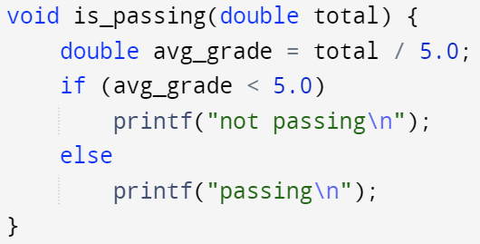
Preprocessor - #define
Solution to magic numbers (numbers hard coded in your program)
Constant literals (5.0), used directly in the code
Makes the code difficult to understand
The is_passing() function tries to determine if a student’s average grade of 5 classes is passing a required threshold (5.0)
Number of classes
Threshold for passing

Slide 10
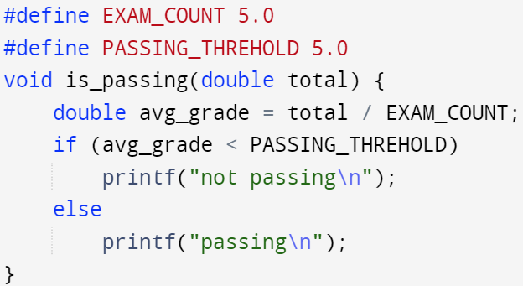
Preprocessor - #define
Solution to magic numbers (numbers hard coded in your program)
Constant literals (5.0), used directly in the code
Makes the code difficult to understand
The is_passing() function tries to determine if a student’s average grade of 5 classes is passing a required threshold (5.0)

Slide 11
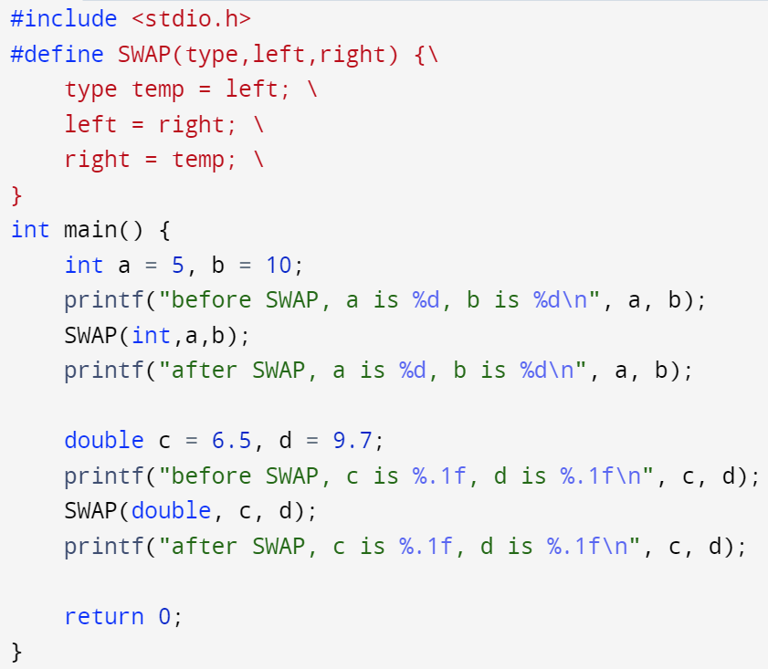
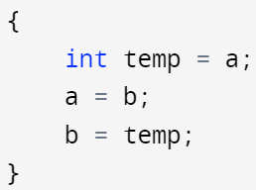
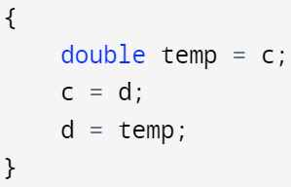
Preprocessor - #define – parameterized macro
#define NAME(ARG1, ARG2, …) CODE
Like regular define, but with parameters
Not a function, just text replacement
CODE may be any piece of code
Use ‘\’ if your CODE takes multiple lines
SWAP(int, a, b) and SWAP(double, a, b) will be replaced with the following code during preprocessing stage

Slide 12
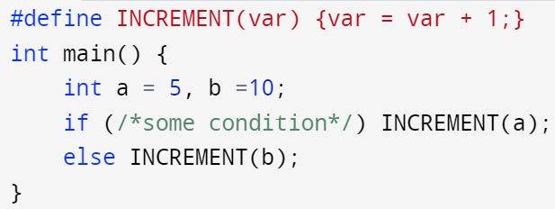
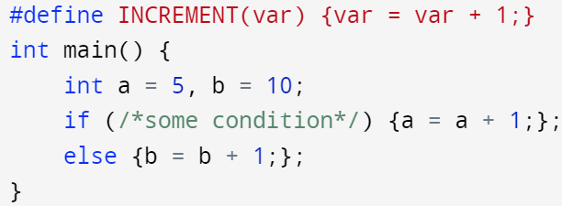
Preprocessor - #define
Parameterized macro is error-prone, use with caution
The following example won’t compile properly
“;” breaks the continuity of the if statement
You may remove this issue by deleting the “;” after the INCREMENT(a) and INCREMENT(b), but it looks very odd
preprocessor

Slide 13
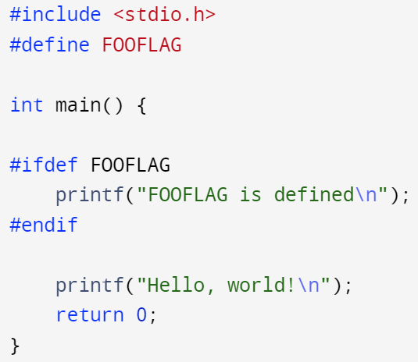

Preprocessor - #define
#define NAME
This is a code/value less macro, it only tells the preprocessor that such a macro exists in the current translation unit
This form of macro is commonly used together with:
#ifdef, #ifndef, #elif, #endif
FOOFLAG is defined, but it is not a name for a piece of code
If FOOFLAG is defined, the piece of code between #ifdef and #endif are preserved in the translation unit, otherwise it’s removed during preprocessing

Slide 14
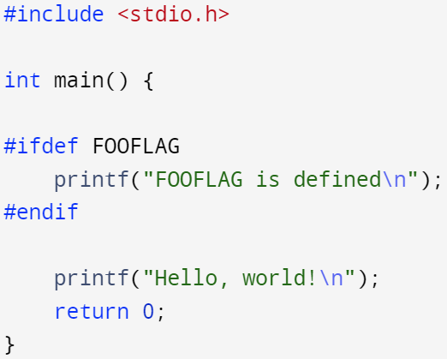
Preprocessor - #define
-D option flag of GCC
gcc –D defines a macro in the associated translation unit, it has two forms:
-D MACRO_NAME: defines a macro named as MACRO_NAME in the translation unit
-DMACRO_NAME: defines a macro named as MACRO_NAME in the translation unit
src.c (preprocessing translation unit)
Nothing about FOOFLAG is printed when executing prog
gcc -o prog src.c
Prints out messages about FOOFLAG when compiled with:
gcc –D FOOFLAG -o prog src.c
or:
gcc –DFOOFLAG -o prog src.c
As if
#define FOOFLAG
is inserted into src.c

Slide 15
Preprocessor – conditional directives
different forms of preprocessing directives
#ifdef MACRO_NAME
<code1>
#else
<code2>
#endif
If MACRO_NAME is defined, run <code1>
Otherwise, run <code2>
The else block is optional
#ifdef must end with #endif
#if EXPRESSION1
<code1>
#elif EXPRESSION2
<code2>
#else
<code3>
#endif
if EXPRESSION1 evaluates to true, run <code1>, else if EXPRESSION2 evaluates to true, run <code2>, else
run <code3>
Both #elif and #else blocks are optional
#if must end with #endif
#ifndef MACRO_NAME
<code1>
#else
<code2>
#endif
If MACRO_NAME is NOT defined, run <code1>
Otherwise, run <code2>
The else block is optional
#ifndef must end with #endif
Expression must have integral type and can include only integer constants, character constants and defined macro
Notes:
https://www.tutorialspoint.com/cprogramming/c_preprocessors.htm
https://learn.microsoft.com/en-us/cpp/preprocessor/hash-if-hash-elif-hash-else-and-hash-endif-directives-c-cpp?view=msvc-170

Slide 16
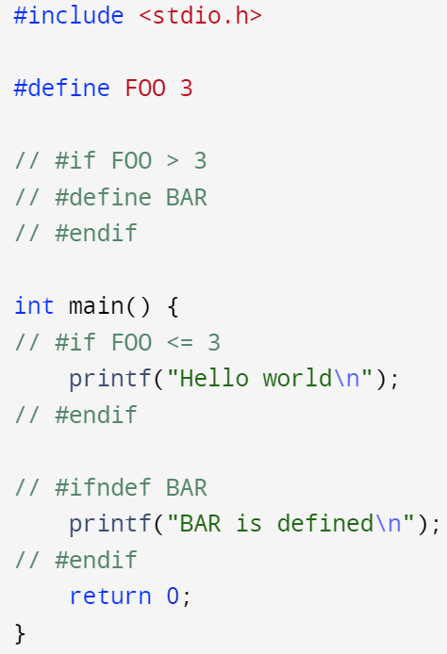
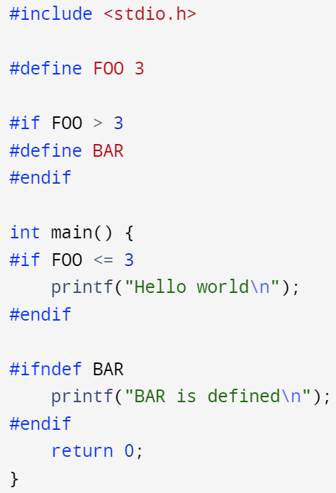
Preprocessor – conditional directives
different forms of preprocessing directives
#if EXPRESSION1
<code1>
#elif EXPRESSION2
<code2>
#else
<code3>
#endif
if EXPRESSION1 evaluates to true, run <code1>, else if EXPRESSION2 evaluates to true, run <code2>, else
run <code3>
Both #elif and #else blocks are optional
#if must end with #endif
Expression must have integral type and can include only integer constants, character constants and defined macro
Notes:
https://www.tutorialspoint.com/cprogramming/c_preprocessors.htm
https://learn.microsoft.com/en-us/cpp/preprocessor/hash-if-hash-elif-hash-else-and-hash-endif-directives-c-cpp?view=msvc-170

Slide 17
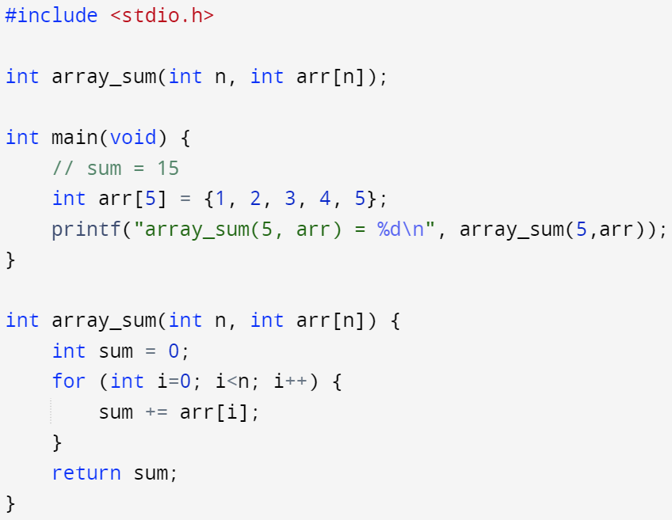
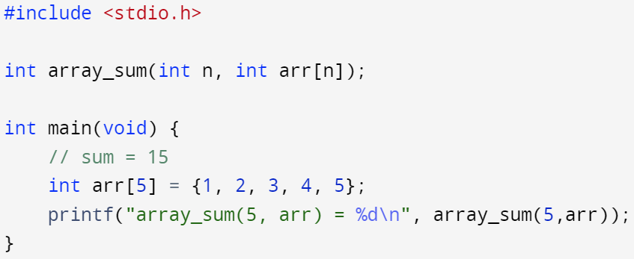
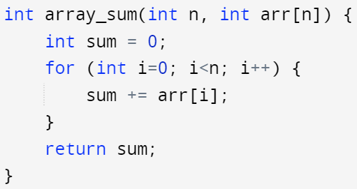
Multi-file program – naïve example
Divide one source file into two separate files, note the array_sum() function prototype in main.c lets the compiler know that such a function exists and tries to link the associated definition later
src.c
main.c
Recap: functions inheritly have extern keyword
arr_util.c
gcc –Wall src.c –o prog –std=c99
gcc –Wall main.c arr_util.c –o prog –std=c99

Slide 18
Multi-file program – naïve example
Issue: if I made changes to function header in arr_util.c, but forgot to change the associated prototype in main.c -> bug
src.c
main.c
arr_util.c
gcc –Wall src.c –o prog –std=c99
gcc –Wall main.c arr_util.c –o prog –std=c99

Slide 19

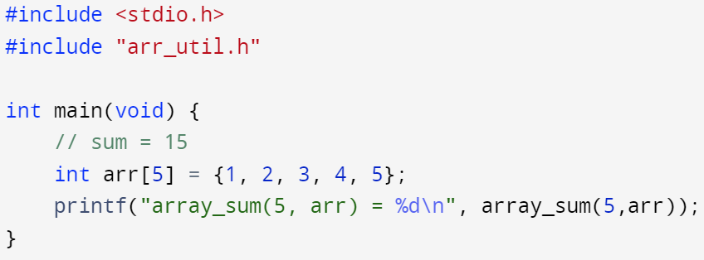
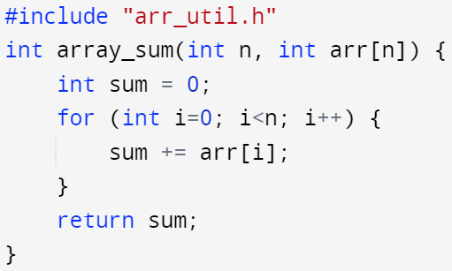
Multi-file program – use header file
Solution: use a customized header file and put the associated function prototype in the header file, once you make a change in arr_util.c, there will be a mismatch between the function definition’s header and the prototype -> fix bug
arr_util.h
src.c
main.c
arr_util.c
gcc –Wall src.c –o prog –std=c99
gcc –Wall main.c arr_util.c –o prog –std=c99

Slide 20
Multi-file program – use header file
Header file is usually used to store
Declaration of functions
Declaration of structured data types (struct, union)
Definition of some macros
We use header file to store declarations to be shared across several source files (e.g., array_sum() in both main.c and arr_util.c)
Two types of header file
The customized header file written by the programmer
The header files come with your compiler (e.g., standard libraries’ header files)

Slide 21
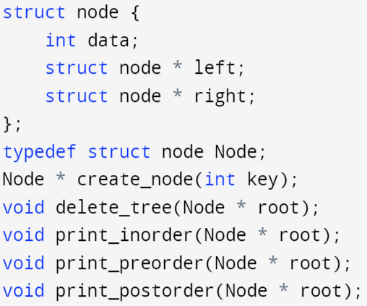
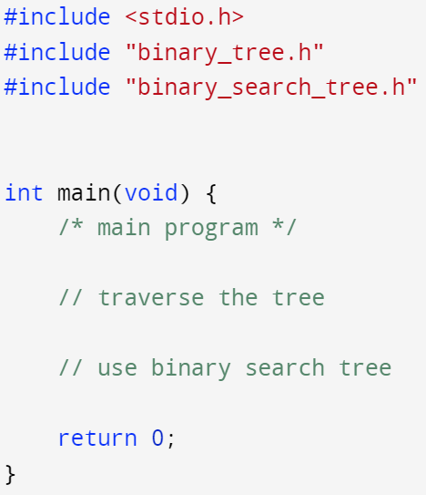
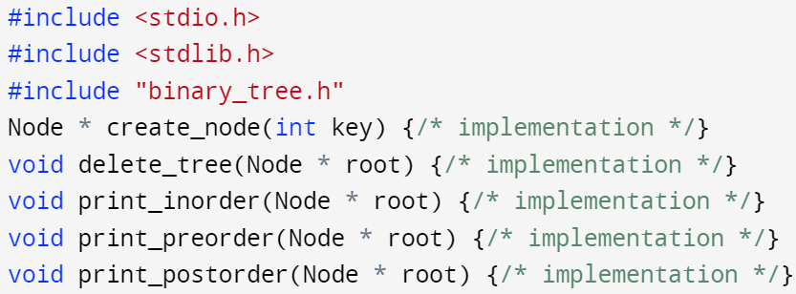
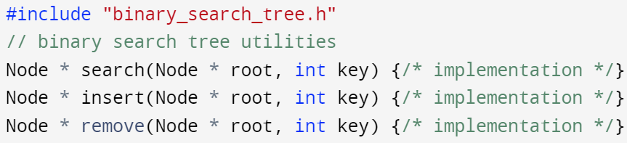
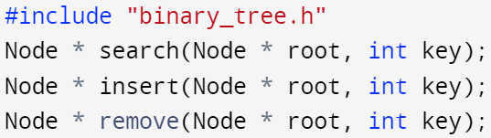
Multi-file program – include guard
Code in binary_tree.h has been copied to main.c for 2 times!
Include guard is used to prevent a header file from being included more than one time in a source file
The following screenshot is an incomplete view of the program
binary_tree.h
main.c
binary_tree.c
binary_search_tree.c
binary_search_tree.h

Slide 22
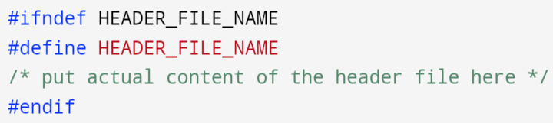
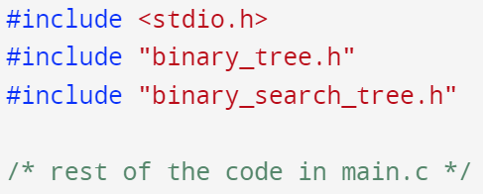
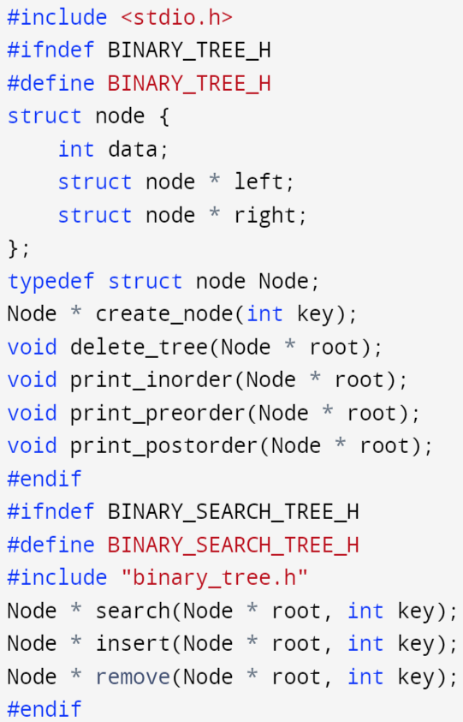
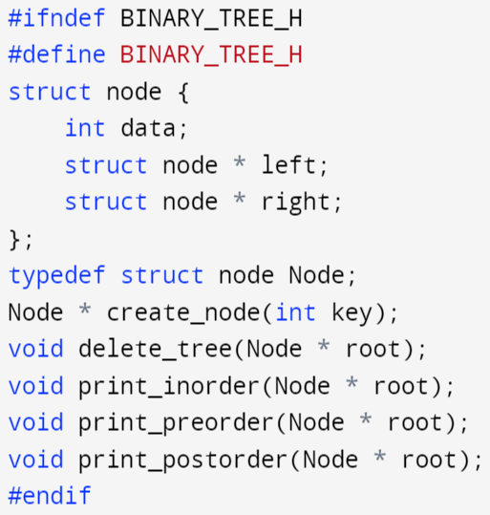
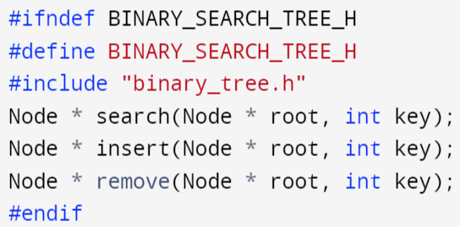
Multi-file program – include guard
Include guard is used to prevent a header file from being included more than one time in a source file
binary_tree.h
main.c
binary_search_tree.h
binary_search_tree.h

Slide 23
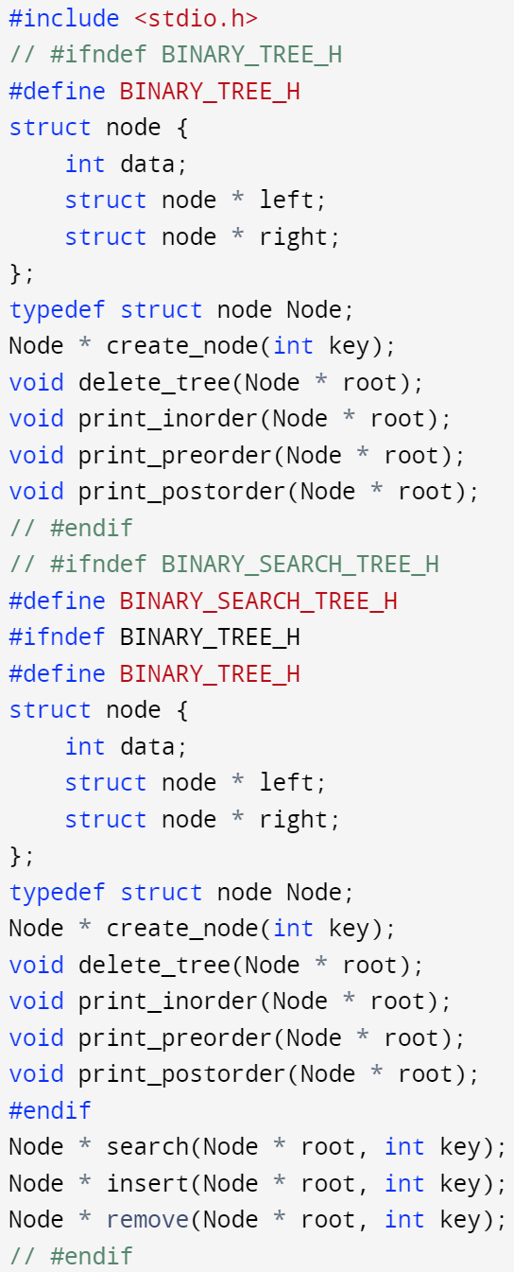
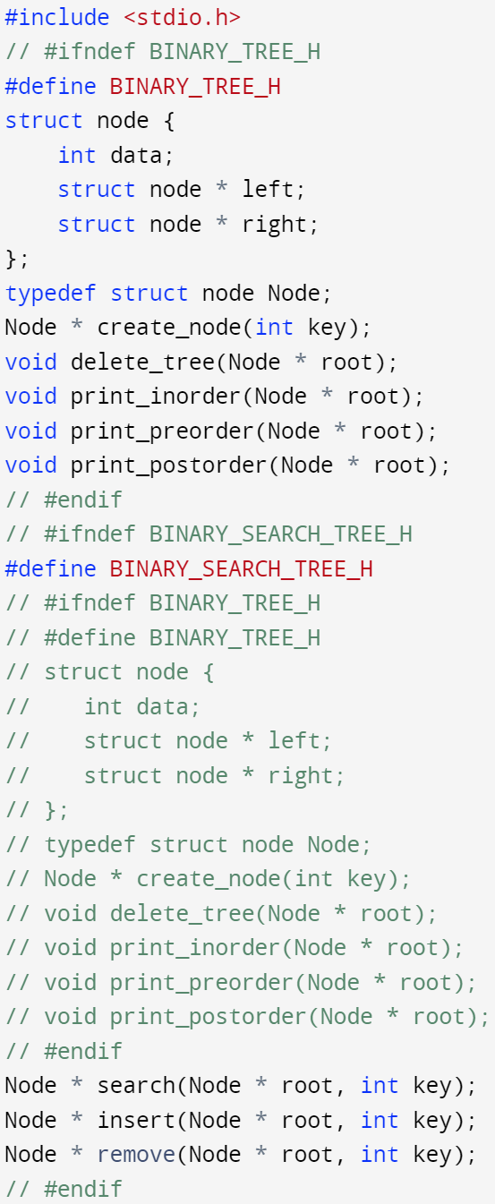
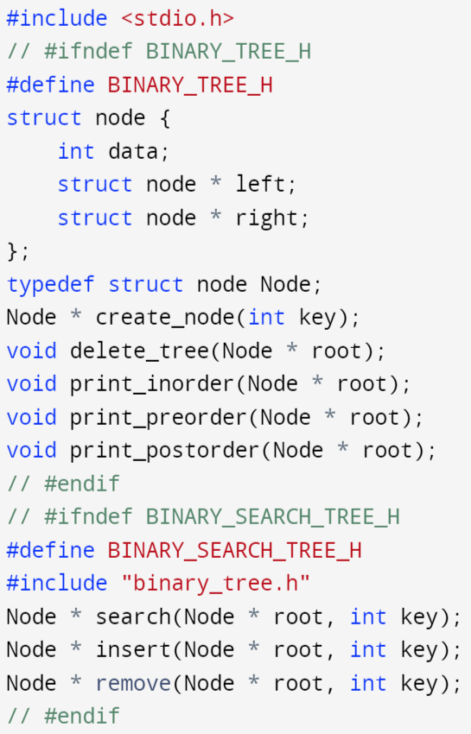
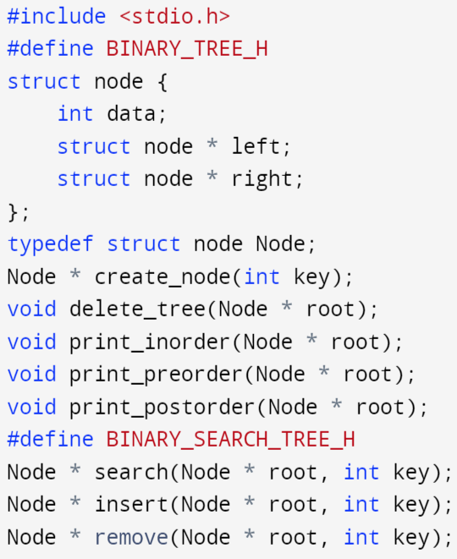
Multi-file program – include guard
Include guard is used to prevent a header file from being included more than one time in a source file
main.c

Slide 24
Multi-file program – include guard
In header file, the macro name should contain the name of the file and some additional text to avoid conflicts with other header files
E.g., myArithmatics.h: #define MYARITHMATICS_TOTAL_COUNT 15
In a user header file, macro name SHOULD NOT begin with ‘_’
Reserved names for macros in headers of standard libraries
External identifiers (global functions and variables) -> see preprocessed source code for these variable declarations
More details about reserved names
https://www.gnu.org/software/libc/manual/html_node/Reserved-Names.html

Slide 25
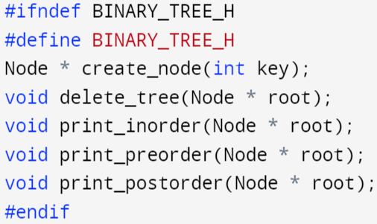
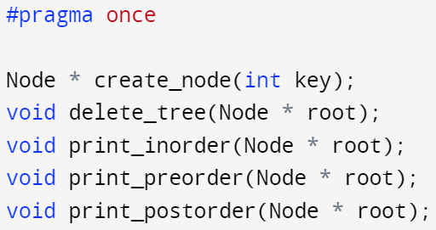
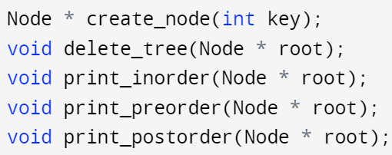
Multi-file program - #pragma
Used to implement compiler specific features (make your own compiler with some specific functionality)
Most common is #pragma once, it’s an easy way of implementing include guard. This is a non-standard widely supported preprocessor directive
#pragma once causes the current header file to be included only once in the associated translation unit
binary_tree.h
binary_tree.h
binary_tree.h

Slide 26
Manually linking object files
In our previous example we have the following files in our project
main.c
binary_tree.c
binary_search_tree.c
binary_tree.h
binary_search_tree.h
We can compile all the .c source files at once:
We can also compile the .c source file one by one with –c option flag:
And link the associated .o object files in the end
gcc –Wall main.c binary_tree.c binary_search_tree.c –o prog –std=c99
gcc –Wall -c main.c –o main.o –std=c99
gcc –Wall -c binary_tree.c –o binary_tree.o –std=c99
gcc –Wall -c binary_search_tree.c –o binary_search_tree.o –std=c99
gcc main.o binary_tree.o binary_search_tree.o –o prog

Slide 27
Manually linking object files
The advantage of compiling each .c file separately
Less compile time
Flexible for changes
We can update one .c file, e.g., binary_tree.c file
Recompile this .c file separately → binary_tree.o (updated)
Link binary_tree.o with other .c files object files → executable (updated)

Slide 28
Make
Writing all these commands by hand is time consuming
It is difficult to keep track of which files have changed
Instead, we can use build tools to handle the work for us
Make is the ubiquitous build tool on UNIX system
Uses files named Makefile (it has to be this name)

Slide 29
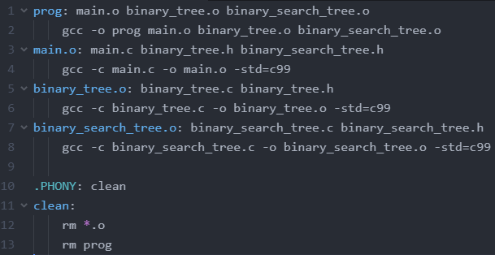
Makefile
Makefile is like a recipe
The file is composed of 1 or more rules
Each rule specifies which file it builds, what are the dependencies of this rule, and how to build the file
If any file in the dependency list of a rule changes → triggers recompile of the associated file
the file this rule builds
How to build prog?
Dependency list of this rule
rules

Slide 30
Makefile
Makefile is like a recipe
The file is composed of 1 or more rules
Each rule specifies which file it builds, what are the dependencies of this rule, and how to build the file
If any file in the dependency list of a rule changes → triggers recompile of the associated file
the file this rule builds
How to build prog?
Dependency list of this rule
rules
a phony rule
(doesn't build a file)

Slide 31
Makefile
Makefile is like a recipe
The file is composed of 1 or more rules
Each rule specifies which file it builds, what are the dependencies of this rule, and how to build the file
If any file in the dependency list of a rule changes → triggers rebuild of the associated file
Needs to use tabs for make command (tab != 4 spaces)
the file this rule builds
How to build prog?
Dependency list of this rule
tab
rules
tab
tab
tab
a phony rule
(doesn't build a file)
tab
tab

Slide 32
How to use the Makefile?
make
Build according to the first rule specified in Makefile
make filename
Runs the rule named "filename".
For example, "make binary_tree.o" or "make clean"
Make keeps track of which files have changed
Uses file modification time stamp
If a file in the dependency list changed, it will trigger rebuild of the associated rule which may trigger cascading rebuild until all the related rules are rebuilt
Only the files that have changed will be rebuilt
Faster compilation

Slide 33
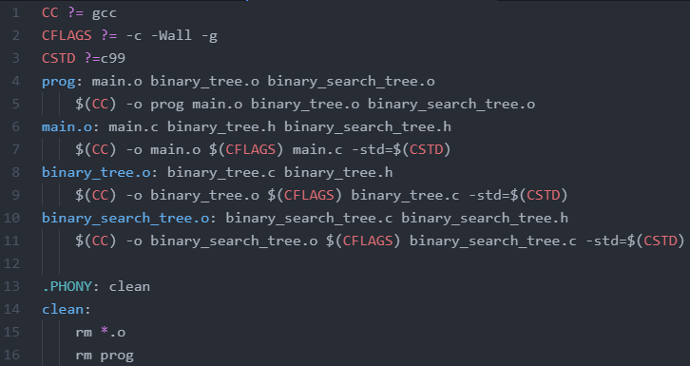
Makefile – generic rules and input argument
You can also write generic rules that apply to the same file type:
CC and CFLAGS are like variables
?= is a conditional assignment
CC is assigned to gcc if its not defined by command line input argument
Use $(var_name) to place the associated variable in the Makefile
$(var_name) will be swapped to the actual value of var_name
E.g., $(CC) will be swapped to gcc if no other input argument is assigned to CC
Passing command line input to make
make CC=clang (switch from gcc to clang compiler)
make CFLAG=“-c –Wall” (only use –c and -Wall)
No extra space between assignment “=” in command line input

